Slide 1

User Manual
Virtual Desktop Assistant - Eve
Author : Kevin Johnson George

Slide 2
Table of Contents
Acknowledgements
About Me
About My Internship Journey With Clevered
About App
Instructions On Using The App
Contact Information

Slide 3
Acknowledgements
I would like to express my sincere gratitude to my mentors, Mr. Ken and my parents for the continuous support I have received during my journey in App Development and for their motivation, guidance and advices that helped me through.

Slide 4
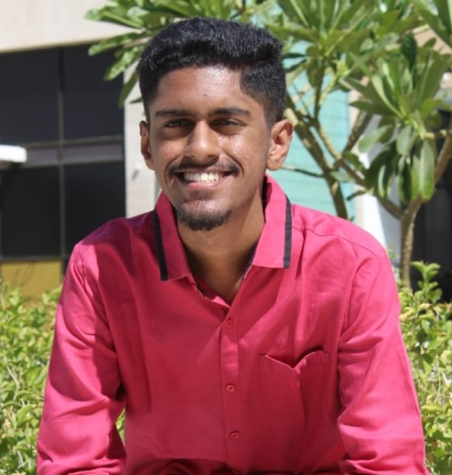
Introduction
About Me
Name: Kevin Johnson George
Age: 19
Education: Bachelor’s Degree in Computer Science
Interests
AI & Machine Learning helps in times of disasters, in the society and improves user experience. The possibility for AI to mature in our environments is high and will change the future as it makes human lives easier.

Slide 5
About My Internship Journey With Clevered
It’s been an amazing journey in learning things I’ve been interested in.
Learning both front-end and back-end coding in this internship has been really educative and effective.
It’s been an enjoyable experience and the live sessions were entertaining.

Slide 6
About App
Virtual Desktop Assistant
About Project
Motive
Benefits
Virtual Desktop Assistant - Eve
Performs tasks/services
Uses voice commands
The project theme brought an interest to me
Capable of multitasking and is more approachable for users
Helps users to perform tasks efficiently
Setting reminders/schedules
Locate local resources
Open applications and many more
Available 24/7

Slide 7
Pages
Sign In
Sign Up
Sign Up Completion
Main
Username
Password
First Name
Username
Password
Confirm Password
Displays user’s entered details
Microphone button – system listens

Slide 8

How Do I Use The App?

Slide 9
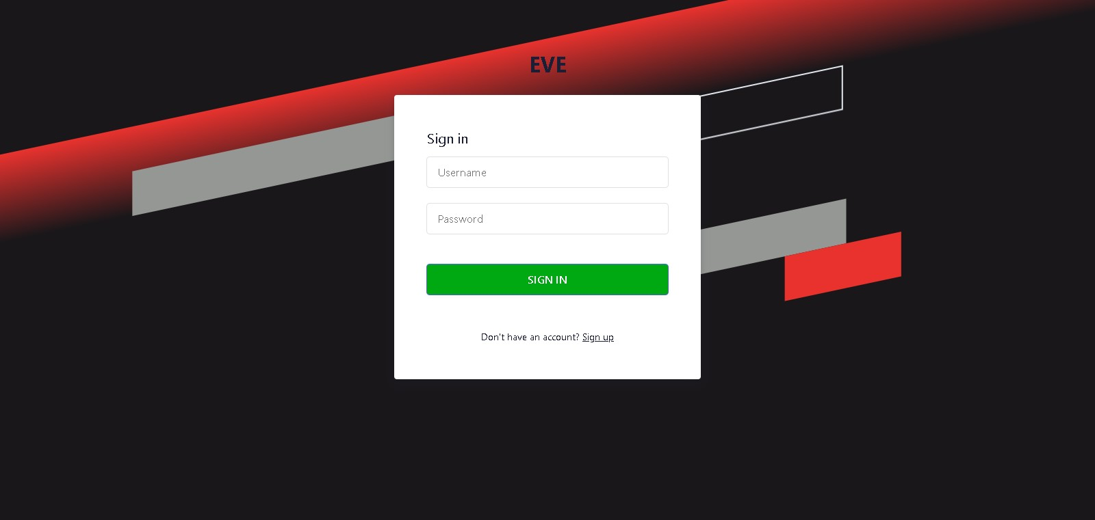
Sign In Page
Here the user enters the correct information where it will then take the user to the main page.
New users can create an account by clicking the Sign Up link

Slide 10
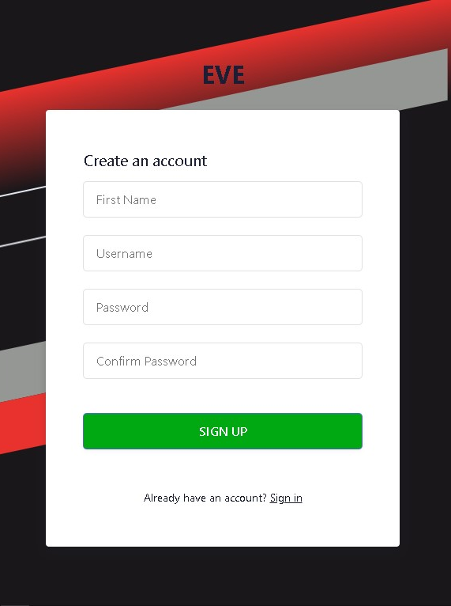
Sign Up Page
Here the user must fill in the required details when signing up.
Once signed up the user will be redirected to the ‘Success’ page.

Slide 11


Success Page
When this page is displayed after signing up, the user has successfully created an account and is ready to sign in.
The details the user entered are displayed below when scrolled down.

Slide 12

User will be greeted in the ‘Main’ page and here is where the user can give commands to Eve when clicking on the microphone button.
The system will then start listening and awaits for the user’s commands and then proceeds to perform the given tasks accordingly.
Main Page

Slide 13
Contact Person
Please reach out to Kevin Johnson George at kev11geo@gmail.com for any questions/concerns/suggestions on the App.

Slide 14

Thank you!!!

